Slide 1
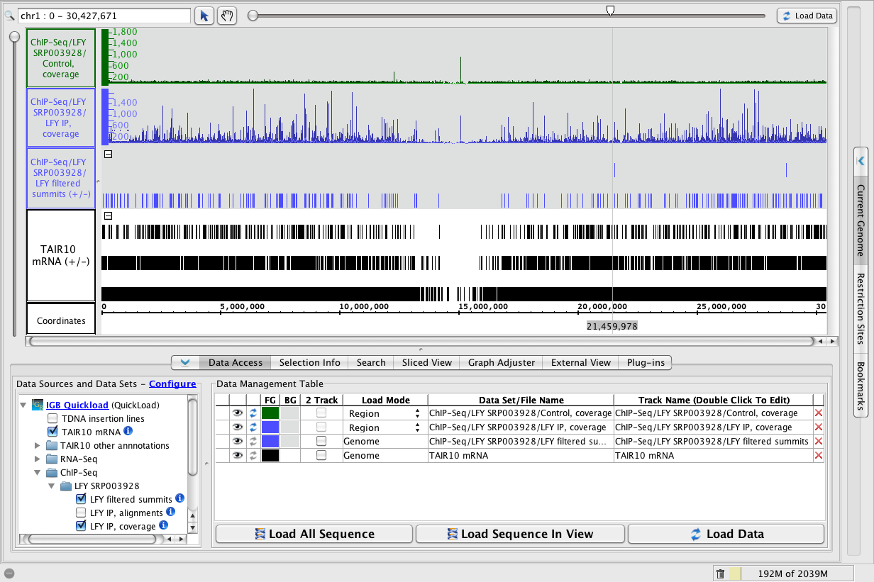
LFY Binding sites on chromosome 1

Slide 2
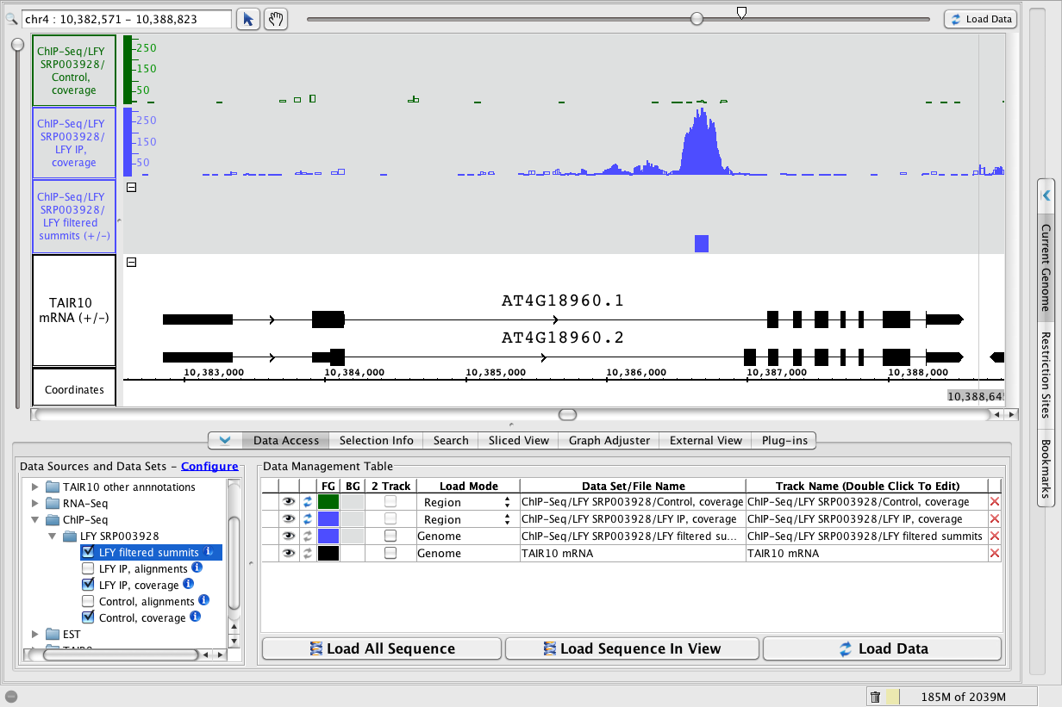
LFY binding site in AGAMOUS
http://www.bioviz.org/igb

Slide 3
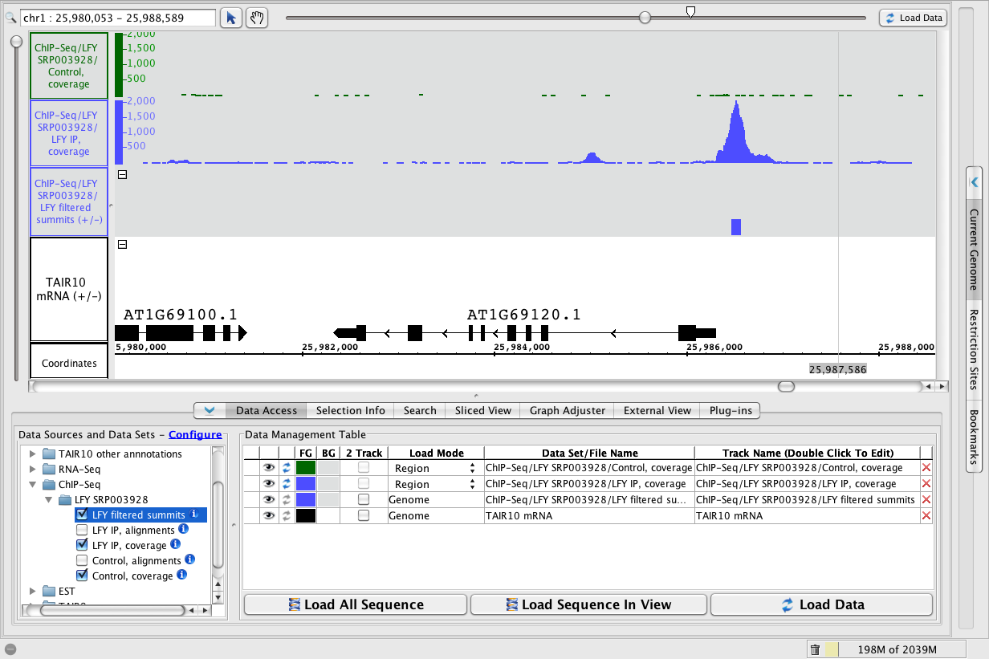
LFY binding site near APETALA
http://www.bioviz.org/igb

Slide 4
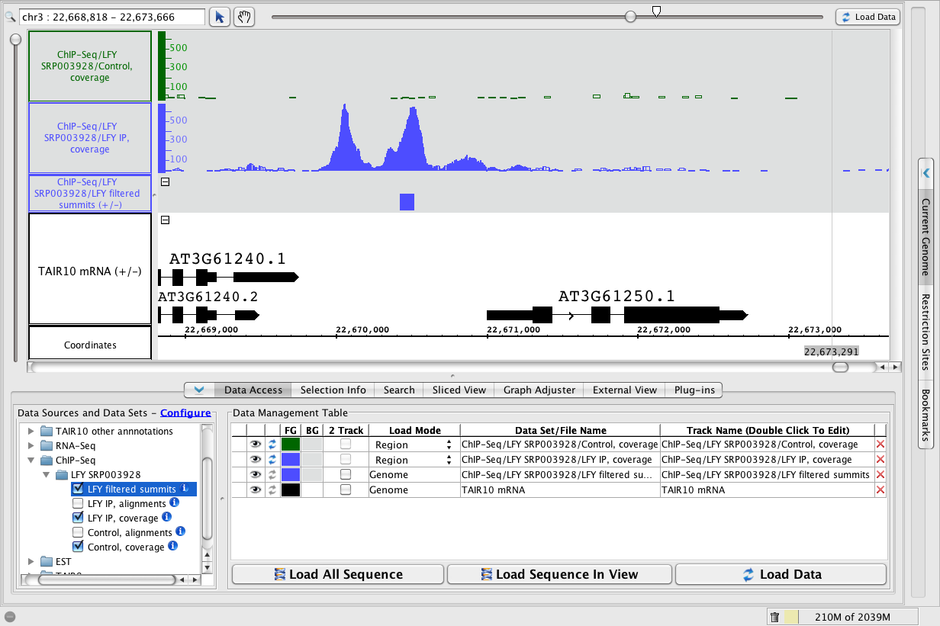
LFY binding site near LMI2
http://www.bioviz.org/igb

Slide 5
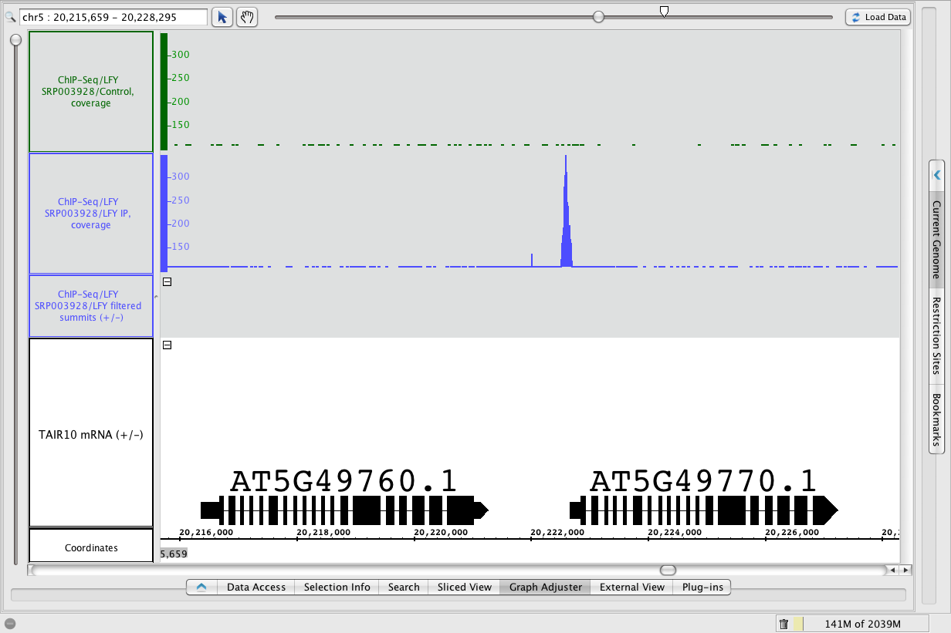
LFY binding site near LMI3
http://www.bioviz.org/igb

Slide 6
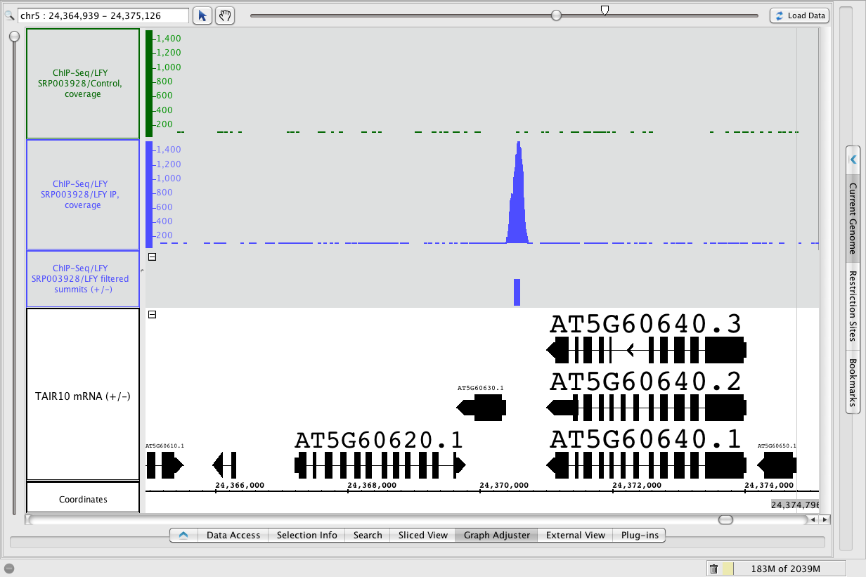
LFY binding site near LMI4

Slide 7
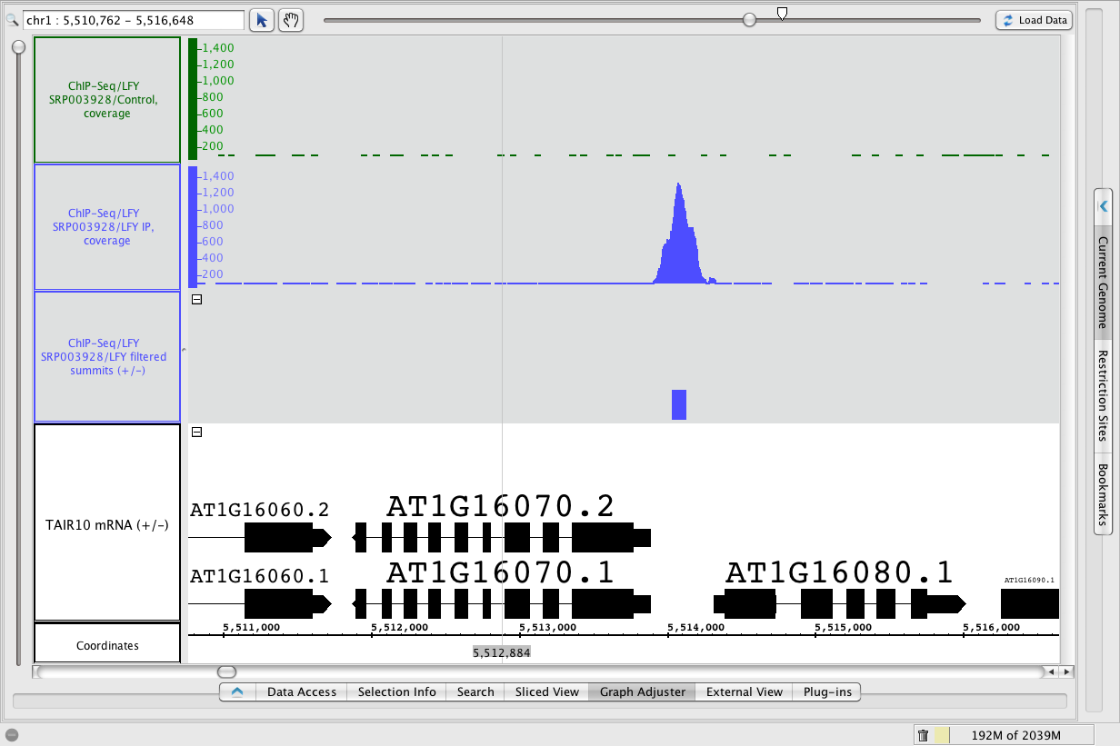
LFY binding site near LMI5
http://www.bioviz.org/igb

